Slide 1
Lung Cancer Detection System Using CNN and Machine Learning Algorithms
Presented by: Pawan Kumar K.P St Joseph Engineering College, Mangalore Guide: Ms. Sumangala N Date:26-07-2025

Slide 2
Introduction
Context:
Lung cancer is the leading cause of cancer-related deaths worldwide, often diagnosed late due to asymptomatic early stages.
Problem Statement:
Traditional diagnostic methods are invasive, expensive, and reliant on specialist radiologists. There is a lack of accessibility in rural areas.
Literature Review:
CNN-based systems have shown expert-level performance in medical image classification. VGG16, in particular, provides strong performance for CT scan analysis.

Slide 3
Objectives
To design a hybrid AI system using CNN-VGG16 for early lung cancer detection through CT images.
To build a multi-user web platform for administrators, doctors, and patients.
Research Questions:
Can CNNs reliably detect lung cancer types from CT images?
Is the system feasible and fast enough for clinical settings?

Slide 4

Methodology / System Design
Frameworks/Tools:
Frontend: HTML5, CSS3, JS
Backend: Flask (Python), MySQL
Model: CNN with VGG16 + custom dense layers
Dataset: IQ-OTH/NCCD (9600 images: Normal, Benign, Malignant)
Preprocessing:
Resizing (224x224), normalization, contrast enhancement, augmentation
Architecture:
VGG16 base + Dense layers
Dropout + SoftMax for classification

Slide 5
Results / findings
Overall Accuracy: 95.25%
Key Metric Formulas
Accuracy = (TP + TN) / (TP + TN + FP + FN)
Sensitivity (Recall) = TP / (TP + FN)
Specificity = TN / (TN + FP)
F1-Score = 2 × (Precision × Recall) / (Precision + Recall) Where:
TP = True Positive
TN = True Negative
FP = False Positive
FN = False Negative
Class-wise Metrics:
Class | Accuracy | Sensitivity | Specificity | F1-Score
Normal | 96.2% | 95.8% | 96.5% | 96%
Benign | 94.1% | 93.7% | 94.4% | 94%
Malignant | 95.4% | 96.2% | 94.8% | 95%

Slide 6
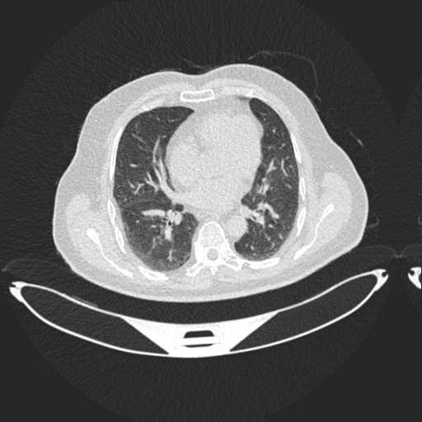
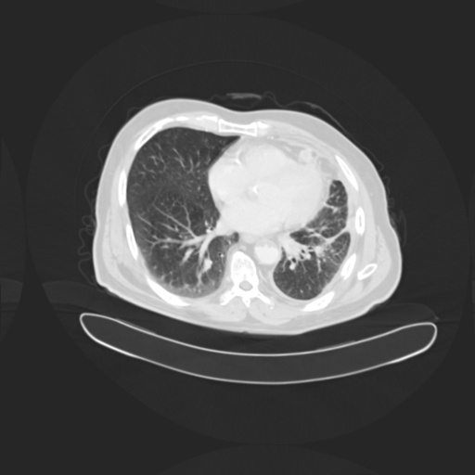
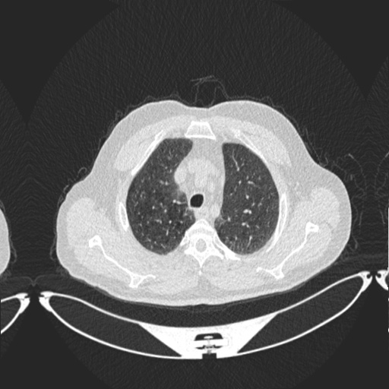
Screenshot – CT Scan Examples
CT-Scan for Benign Case
CT-Scan for Benign Case
CT-Scan for Benign Case

Slide 7
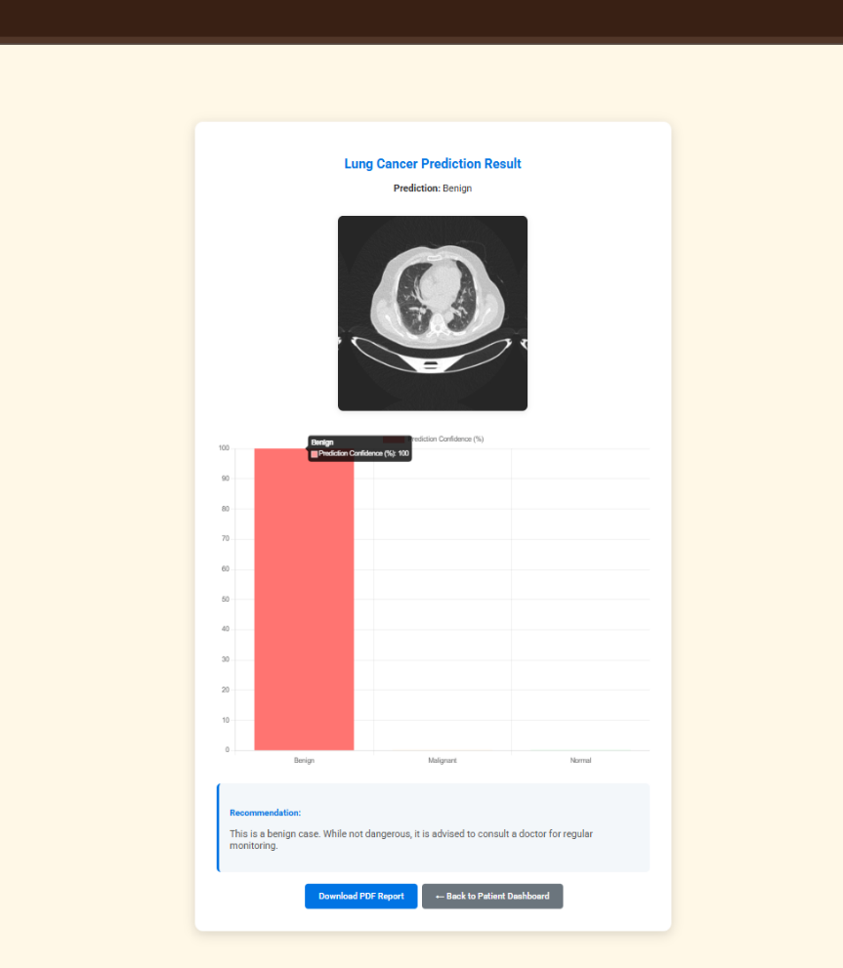
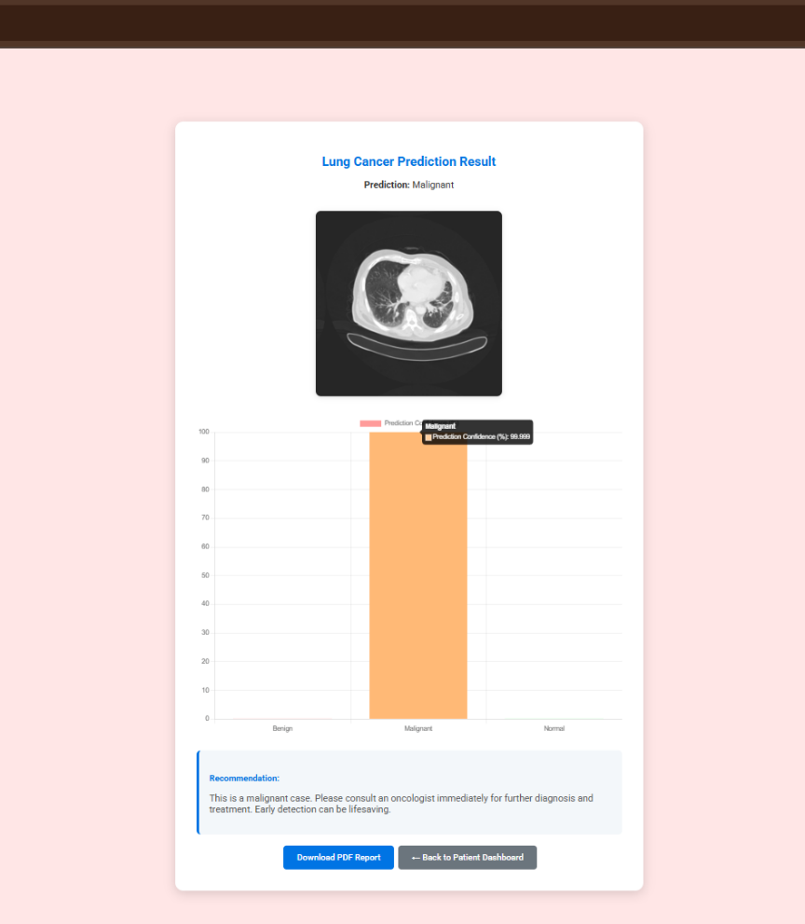
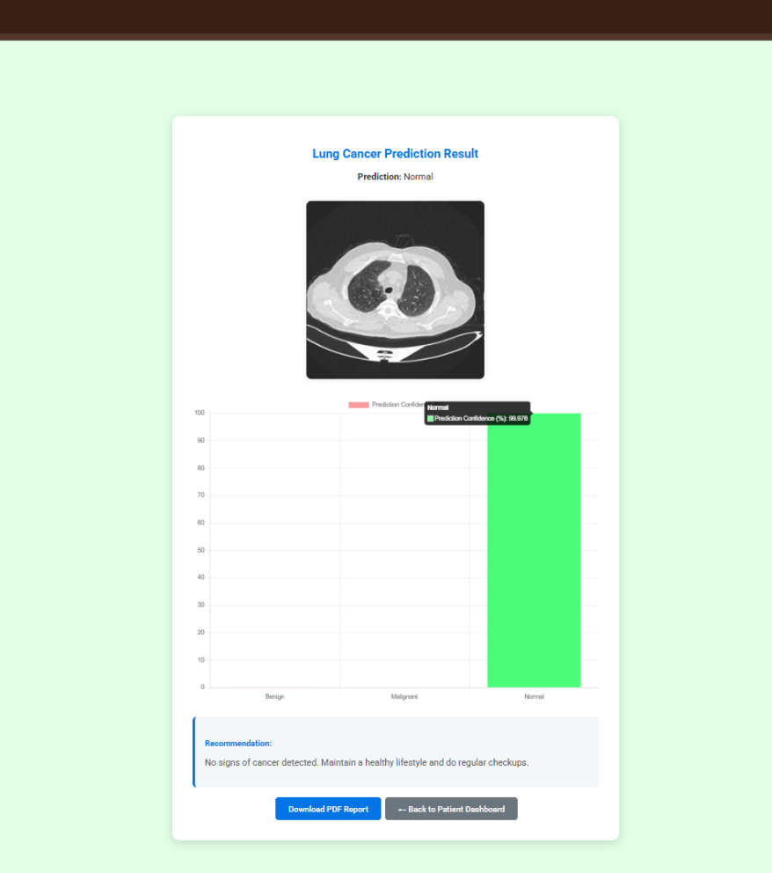
Screenshots CT-Scan Input and Accuracy Output
Benign Case Prediction Page
Malignant Case Prediction Page
Normal Case Prediction Page

Slide 8
Conclusion & Future Enhancement
Summary:
Achieved 95.25% accuracy in lung cancer
detection using VGG16.
Reduced diagnostic time and cost using a
web-based platform.
Contributions:
Multi-role AI diagnostic system.
Strong performance with real-time prediction.
Limitations:
Works poorly with low-quality or corrupted images.
Desktop-only access;
no mobile compatibility.
Future Work:
Expand dataset with rare pathologies.
Deploy on cloud or mobile platforms.
Add clinical validation with hospitals.

Slide 9
REFERENCES
R. L. Siegel et al., CA Cancer J Clin, 2023 (Statistics)
T. Kadir & F. Gleeson, Transitional Lung Cancer Research, 2018 (Imaging)
S. K. Lakshmana Prabu et al., Future Gen Comp Sys, 2019 (Model)
D. Ardila et al., Nature Medicine, 2022 (3D-CNN)
W. Alakwaa et al., Lung Cancer, 2018 (Detection)

Slide 10

Thank you
Pawan KUmar

